Slide 1


Predicting Employee Attrition
Ramizuddin Mohammed Shabuddin

Slide 2
Contents
Problem statement
Proposal
Process overview
Data and Exploratory Data Analysis
Data visualization
Challenges
Result - Conclusion

Slide 3
Problem statement
Departing employees from organization over time is called Attrition. Employee attrition is one of the critical factors which affects the organization.
For organizations to be successful, it is essential that the employer and the employee have a good relationship.
If the employee decides to leave the organization, there will be challenges the organization faces. It will impact productivity, revenue, experience, and time invested in training.
Reasons to leave the organization include worklife balance, retirement, job mismatch and overtime.

Slide 4
Proposal & Process Overview
Proposal:
Machine learning algorithms to predict if the employee will leave the organization or retained.
Train and test models
Compare model performance and select the best model
Process Overview:
Data used will be analyzed
Data preparation and cleaning for any missing values
Perform Exploratory Data Analysis
Train and test models
Model tuning

Slide 5
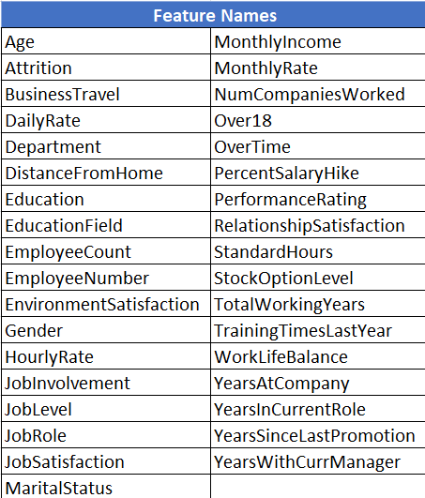
Data Understanding
Data Source: This is a fictional dataset created by IBM data scientists. This dataset consists of 1,470 records. https://www.kaggle.com
Data Sets: csv files – WA_Fn-UseC_-HR-Employee-Attrition.
Data Variables: Dataset describe details about the Employee’s Education, Environment Satisfaction, Job Satisfaction, Performance Rating, Work-life balance, Age, Attrition, Daily Rate, Monthly income of the employee, Marital Status, department of work, distance from home to work for the employee and many other fields.

Slide 6
Data and Exploratory analysis
Data used will be analyzed
Data preparation and cleaning for any missing values
Perform Exploratory Data Analysis
Train and test models
Model tuning
Load
Load the dataset.
Update
Update column names for readability and dropped unnecessary columns.
Handle
Handle missing and null values.
Convert
Convert non-numeric to numeric value.
Create
Create multiple graphs and analyzed the dataset.

Slide 7
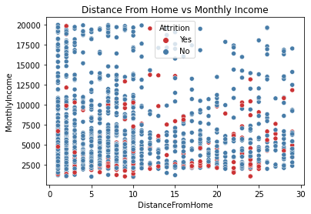
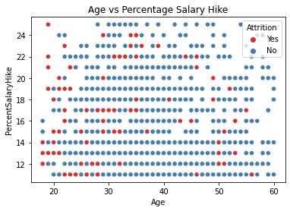

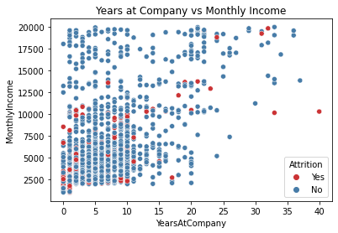
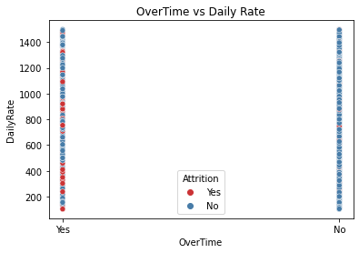
Data and Exploratory analysis
Irrespective of distance from home, If the monthly income is less then the employee is most probable to leave the organization
The probability of number of employees leaving the organization, when they are young and get less percent salary hike.
If the years at company is lesser and the monthly Income is low. The probability of employee leaves the organization.
If there are overtimes in the organization, employees will leave.

Slide 8
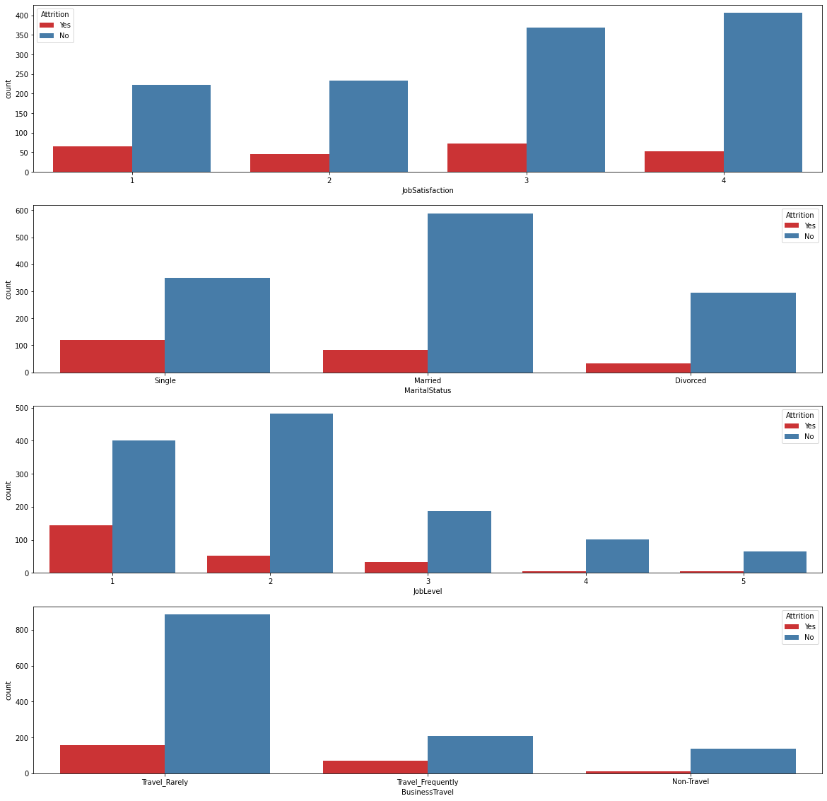
Data and Exploratory analysis
Employees with less Job Satisfaction are more likely to leave.
Employees who are not married are more like to leave.
Employees with JobLevel 1 are more likely to leave.
Employees who travel a lot are more likely to change job as compared to others.

Slide 9
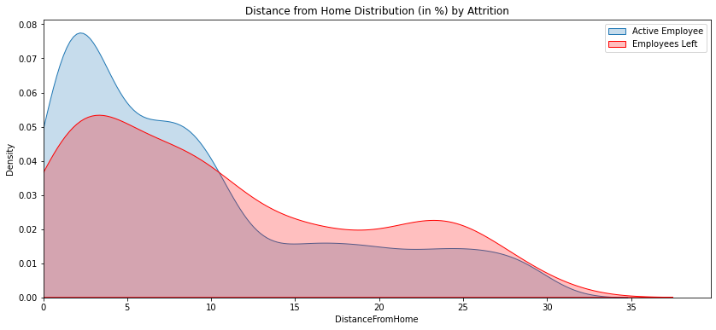
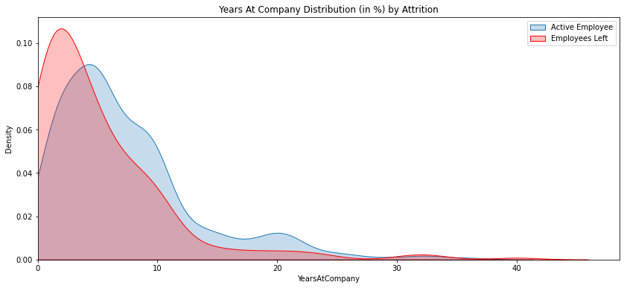
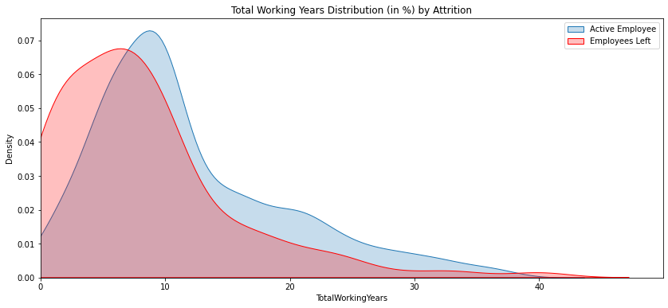
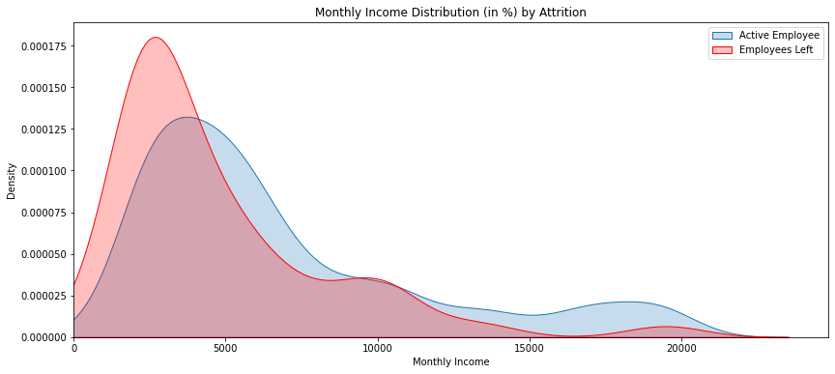
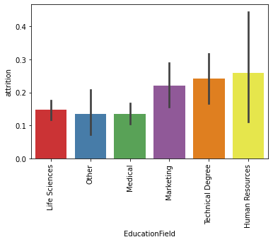
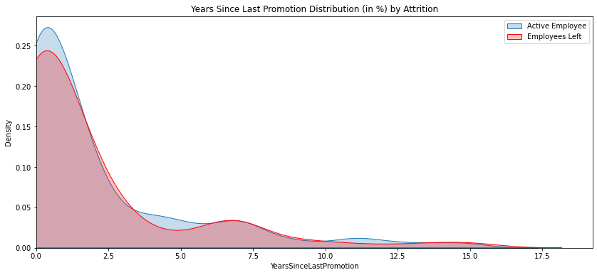
Data and Exploratory analysis
Employees traveling more than 10 miles are more likely to leave.
Employees are more likely to leave in the initial couple of years at the company.
Employees at the early stage in work profile are more likely to leave (less than 7 years experience). Also, after 40 years as well.
Employees with monthly income of less than 5,000 are more likely to leave.
Promotion does not show a large effect on Attrition. The distribution is very similar.
Employees with education level Human Resources are more likely to change job.

Slide 10
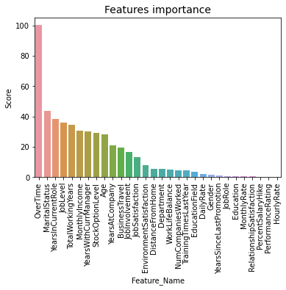
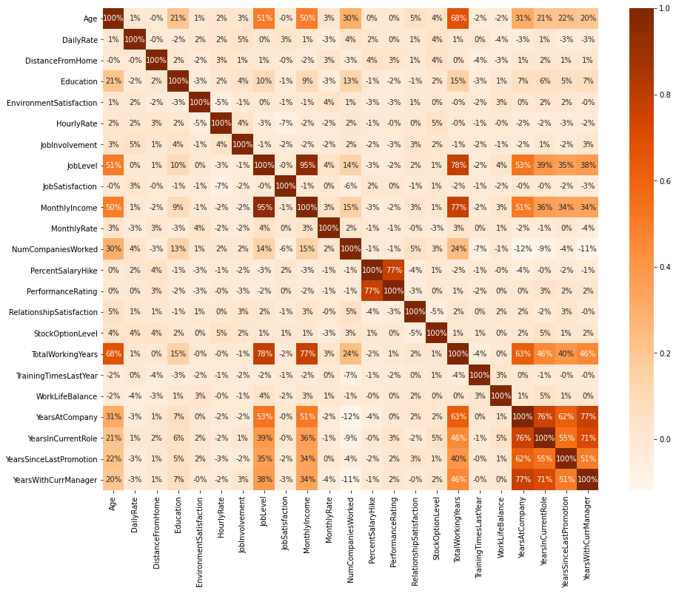
Data Visualization
As per SelectKBest 'OverTime' is one of the important features.
The heatmap shows that correlation of columns.

Slide 11
Challenges
Observation in one feature of was higher than the observation in other class which created a class imbalance.
There were 1233 records as No and 237 records with value of Yes as value.

Slide 12
Result Conclusion
Model | Accuracy
Logistic Model Accuracy | 81.17 %
Decision Tree Model Accuracy | 62.27 %
Random Forest Model Accuracy | 79.57 %
SGDClassifier | 76.81 %
Logistic Model Accuracy is giving the highest accuracy of 81.17%.
Attrition is more in Job level1, between age 25 to 35 and less previous experience
‘OverTime’ is an important factor in employee attrition.

Slide 13
References
Abbott, D. (2014). Applied Predictive Analytics: Principles and Techniques for the Professional Data Analyst (1st ed.). Wiley.
Siegel, E. (2016). Predictive Analytics: The Power to Predict Who Will Click, Buy, Lie, or Die (Revised and Updated ed.). Wiley.
https://www.toolbox.com/hr/engagement-retention/articles/what-is-attrition-complete-guide/
https://www.abacademies.org/articles/predictive-analytics-in-employee-churn-a-systematic-literature-review.pdf
https://towardsdatascience.com/people-analytics-with-attrition-predictions-12adcce9573f
https://medium.com/swlh/exploratory-data-analysis-employee-attrition-rate-591ce8e7518f
https://analyticsindiamag.com/predictive-attrition-model/

Slide 14

Thank you

